Slide 1
https://goo.gl/rWuPh9

Slide 2
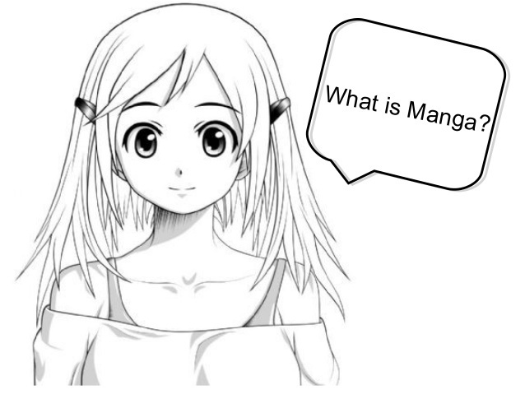
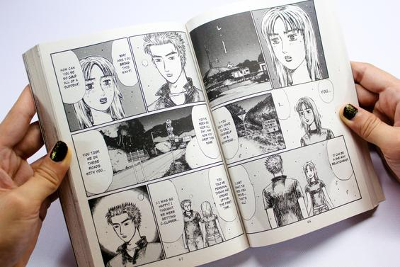
Manga is Japanese comic books. Manga is often made into Japanese cartoons or Anime. The art in Manga has a very definite look to it and is often referred to as “Manga Style.”

Slide 3
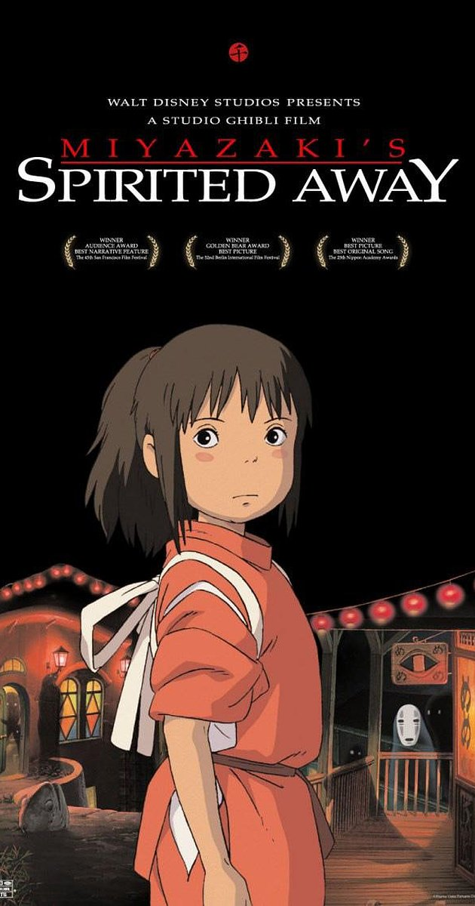
https://www.youtube.com/watch?v=ByXuk9QqQkk

Slide 4
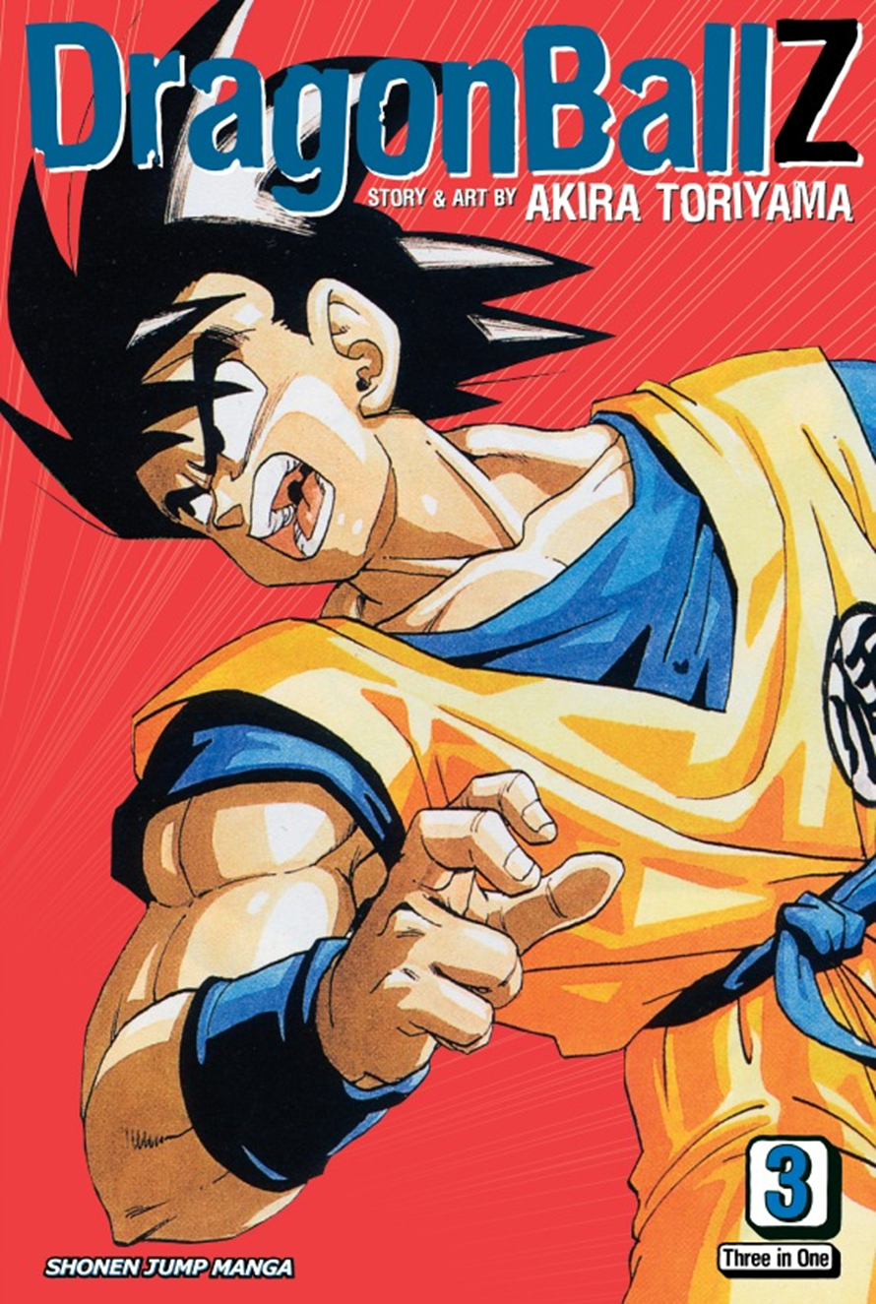
The word Manga can be translated as, “humorous pictures.” Manga became very popular in the 20th century when laws prohibiting the publication of those kinds of items were lifted. It has since become a huge part of Japanese culture. Unlike in America, Manga is read by most people in the country. The artists and writer of Manga are well respected for their work, much like the writers of literature in America.

Slide 5
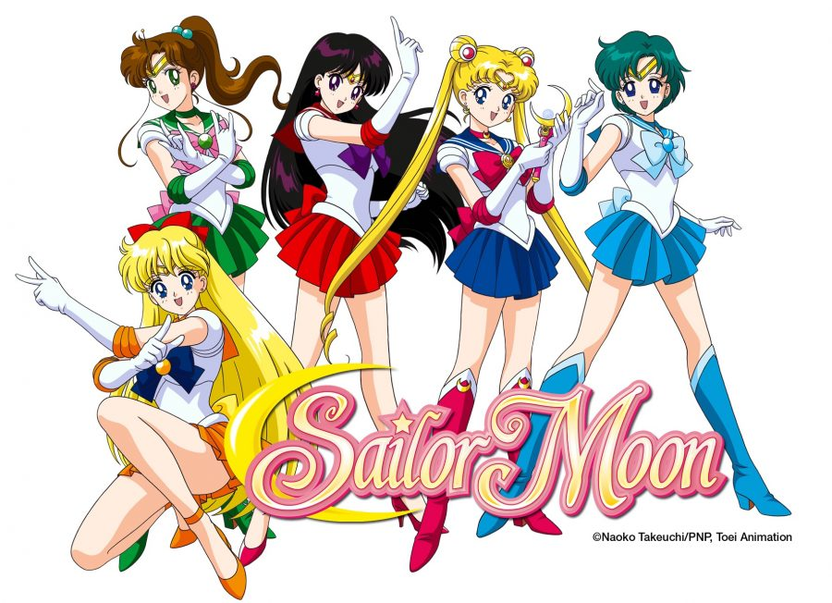

Slide 7
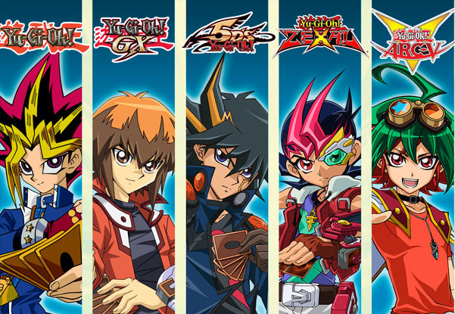

Slide 8
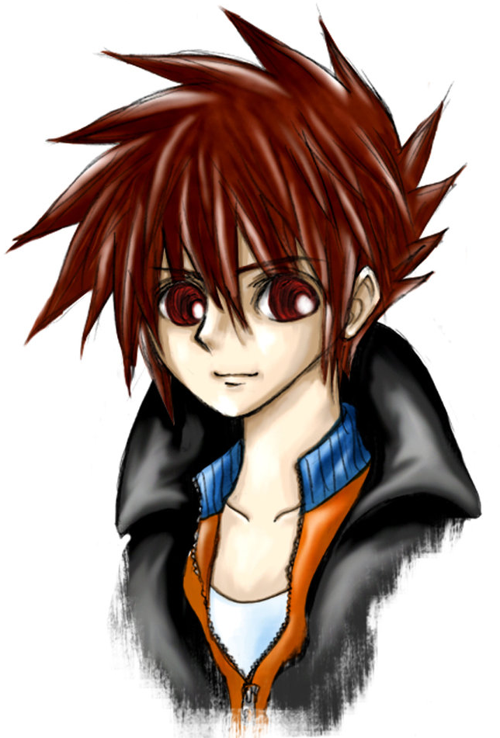
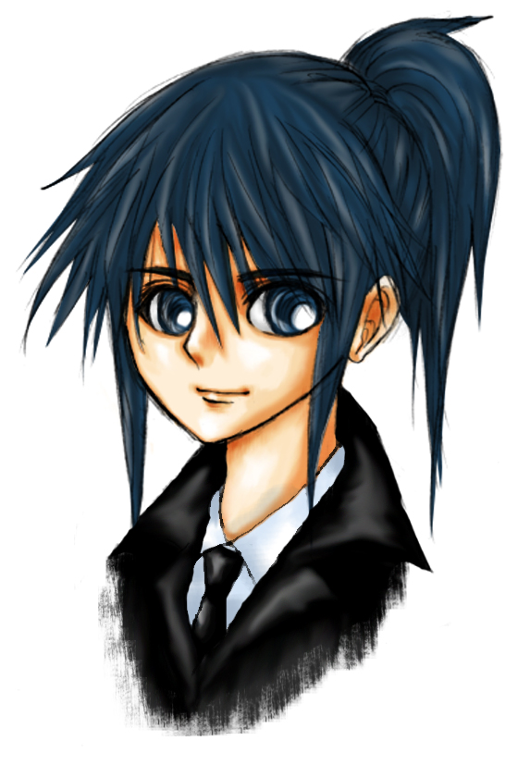
The largest thing that Manga art is known for is its characters. Manga characters almost always have large eyes, small mouths, and they also usually have abnormal hair color. These things give their characters a very western look to them.

Slide 9
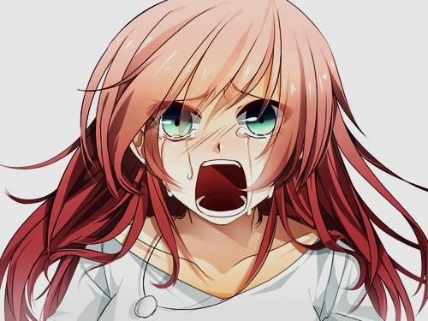
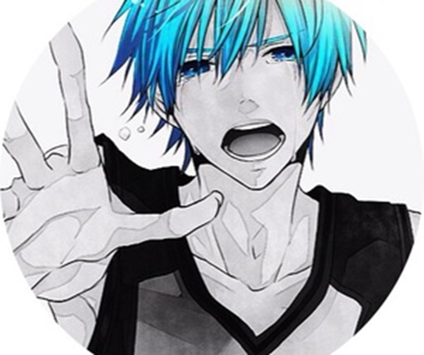
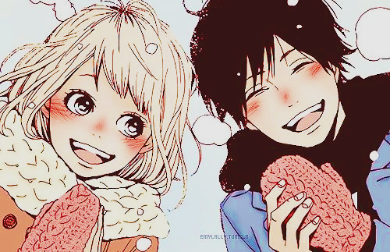
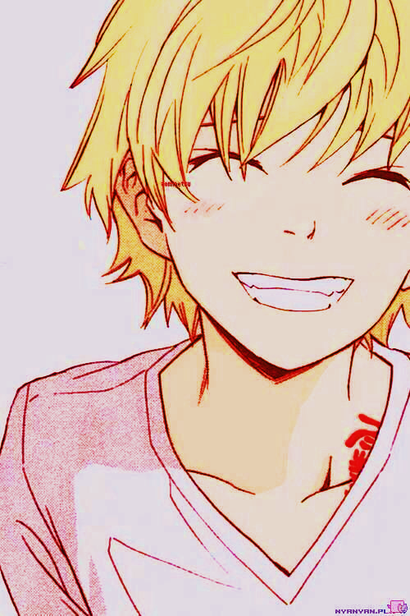
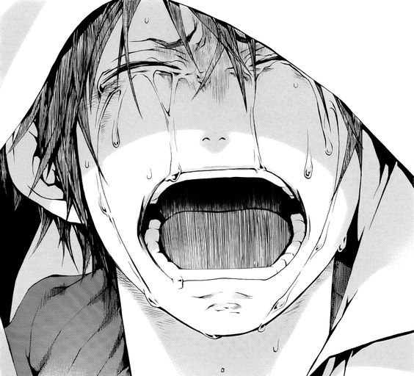
Manga characters usually show over exaggerated emotions. When a character cries, it usually pours out in buckets, when they laugh, their face seems engulfed by the size of their mouths and their eyes become slits. An angry character will have rosy cheeks and steam rolling from around their body. This use of emotion would most likely be categorized as cartoonish.

Slide 10
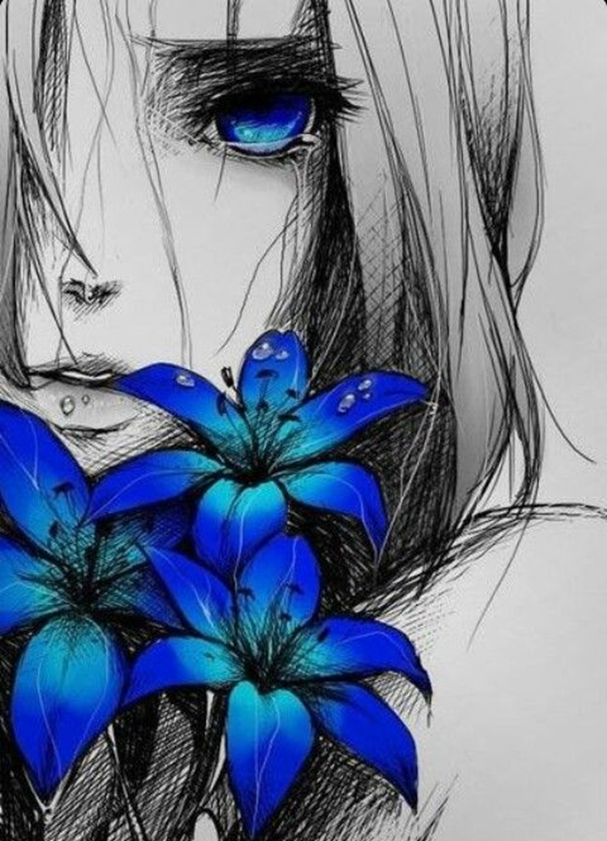
What is the Difference Between Anime and Manga?
There is a big difference between Anime and Manga and don't make the mistake of getting them confused.
According to Wikipedia, Anime is "a term used to refer to Japanese animated productions featuring hand-drawn or computer animation" and Manga are "comics created in Japan, or by Japanese creators in the Japanese language, conforming to a style developed in Japan in the late 19th century." So basically, in very simple terms, Anime is a cartoon and Manga is a comic.
Rochelle Cavane

Slide 11
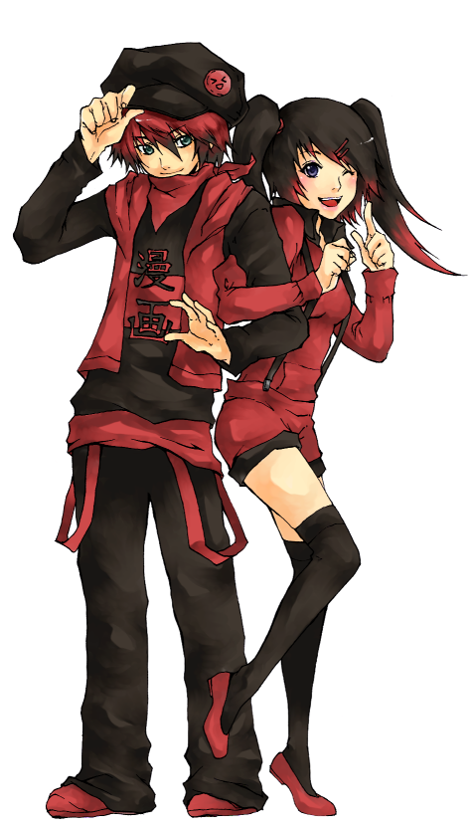
Hair - Manga hair is simple, without defined strands. It is frequently unnatural in color and the style defines the personality of the character. For example, pink hair is used on a cute, bubbly girl. Blue hair signifies a character that has a lot of youthful energy and black or brown hair is considered average. Spiky, wild hair commonly signifies an adventurous spirit.
Eyes - Manga eyes, when open, are drawn enormously large with white reflective patches. Laughing or crying eyes are often shown as simple arcs, with an eyelash or two for definition.
Noses - Manga noses are barely there or completely non-existent.
Mouths - Manga mouths are tiny when closed and huge when open. Details such as lips are usually ignored. Traditional Japanese culture considers showing teeth to be impolite so most Manga characters smile without showing teeth and cover their mouths politely when laughing.

Slide 12
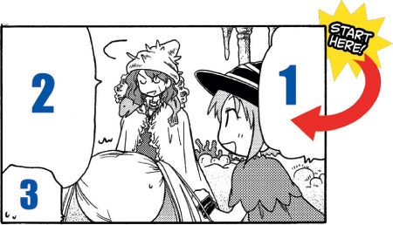
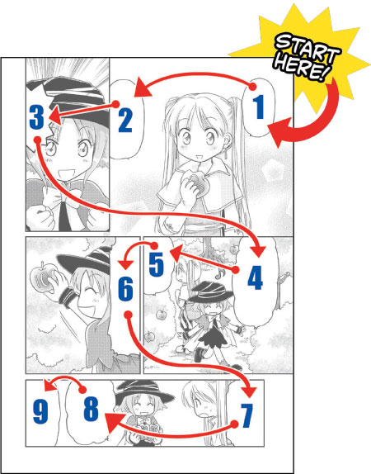
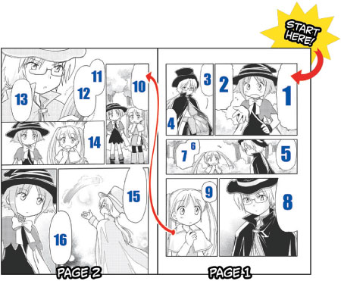

Slide 13
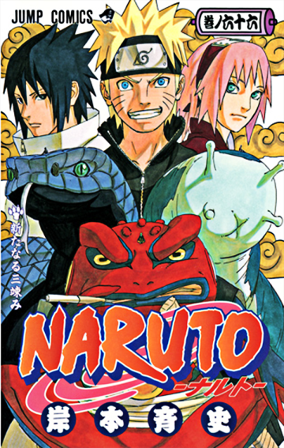
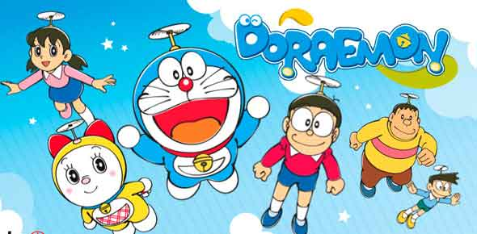
Shōjo is manga aimed at teen and preteen females and literally means "young woman". Shōjo manga tends to have female leads, romantic subplots and resolutions involving personal growth. This doesn't mean Shōjo is devoid of action, though. In addition to more traditional romance stories, Shōjo can include tales of strong and heroic girls too!
Shōnen is manga for teen males. Shōnen manga is the most popular form of manga primarily intended for boys between the ages of 12 to 18. Shōnen manga is typically characterized by high-action, humorous plots featuring male protagonists, camaraderie between boys or men on sports teams, fighting squads is often emphasized. Naruto, Full Metal Alchemist, Dragon Ball Z, are some examples.
Kodomo is manga for children. These stories are often moralistic, teaching children how to behave as good and considerate people and helping them to stay on the right path in life.

Slide 14
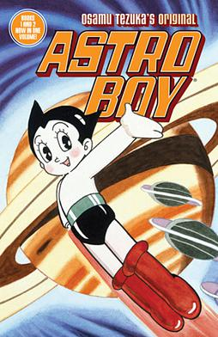
Historical Background:
Manga, or Japanese comic books, are speculated to have originated with picture scrolls created by Buddhist monks around the sixth and seventh century. Wood blocks and picture stories flourished in 18th and 19th century Japan, and modern manga developed in the post-World War II era. Led by artist Osamu Tezuka's creation of Astro Boy in 1951, manga became massively popular, both in Japan and overseas. Although people of all ages enjoy the diverse themes and stories of comic and graphic novels, manga has recently become increasingly popular with American youth.

Slide 15
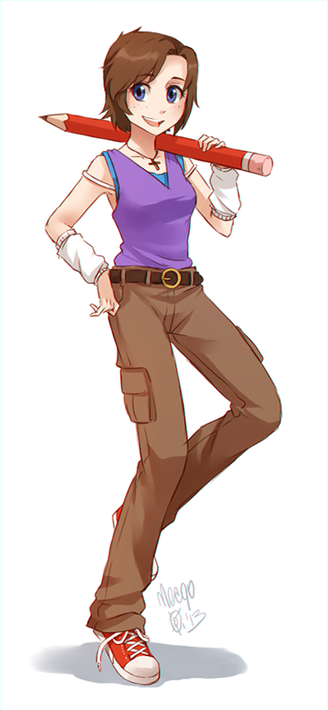
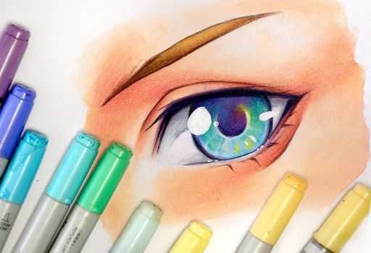
Manga (“mon-gah”) has a long and rich history in Japanese culture. It serves as an important medium for stories. Today hundreds of different manga stories are created each month for readers. Manga has provided the world with some of the most interesting and exciting characters such as Astro Boy, Dragonball Z, and Inu Yasha.

Slide 16
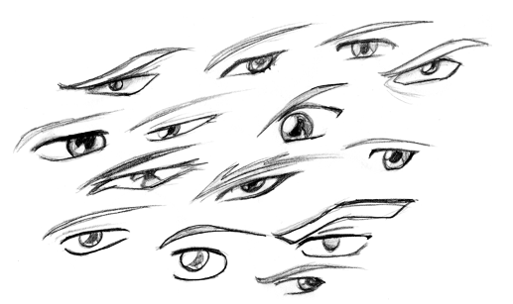
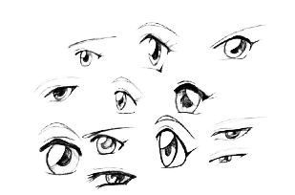
Female Eyes:
Female eyes are typically larger and rounder in comparison to male eyes, with a slight emphasis on the eye lashes.
Male Eyes:
Male eyes are typically narrow and thin, in comparison to the female eyes, with a large emphasis on the eye brow.

Slide 17
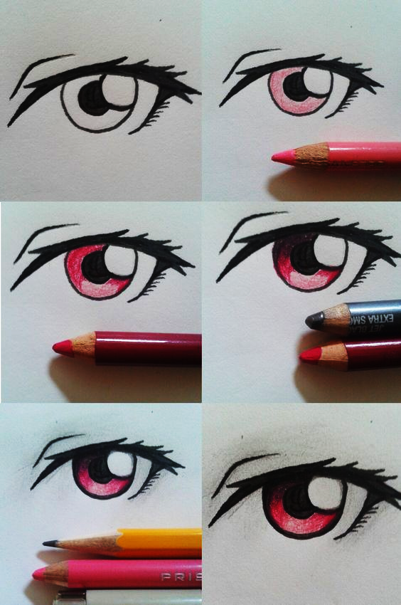
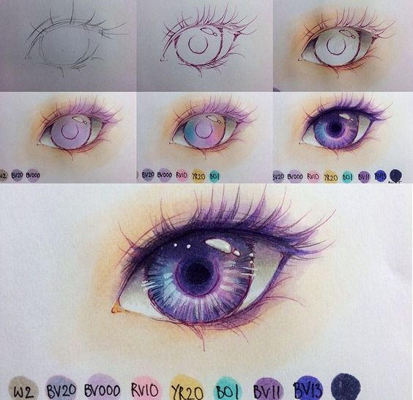
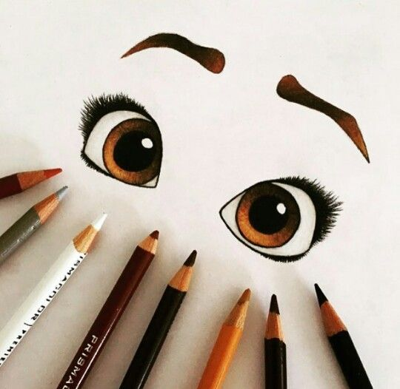

Slide 18
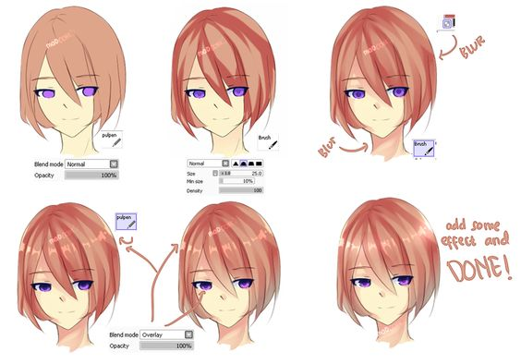
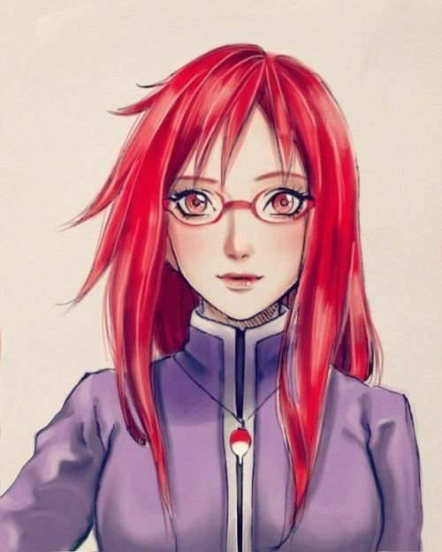

Slide 19
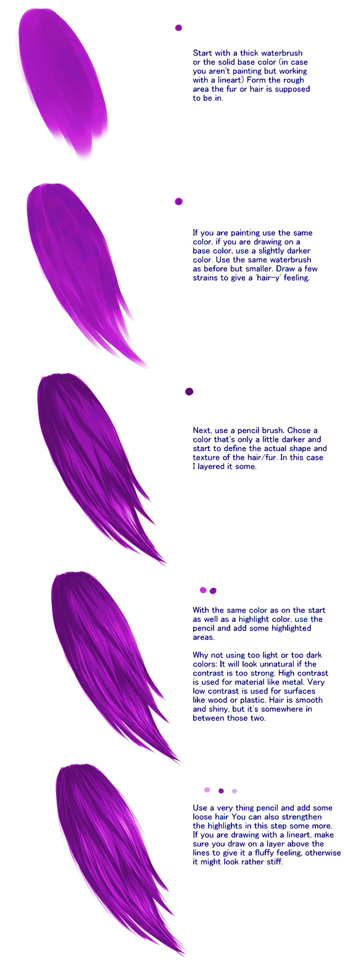
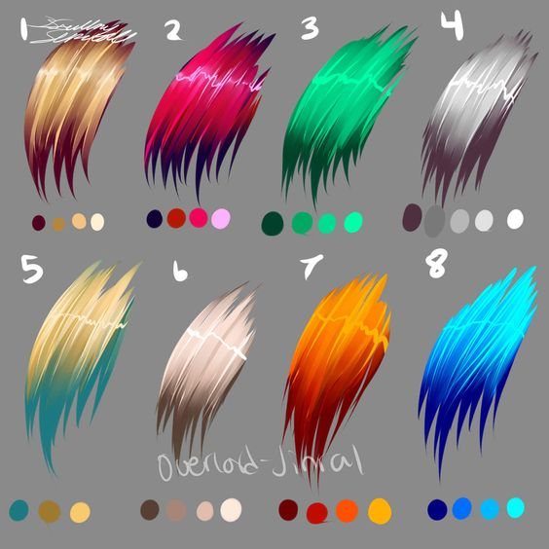

Slide 20
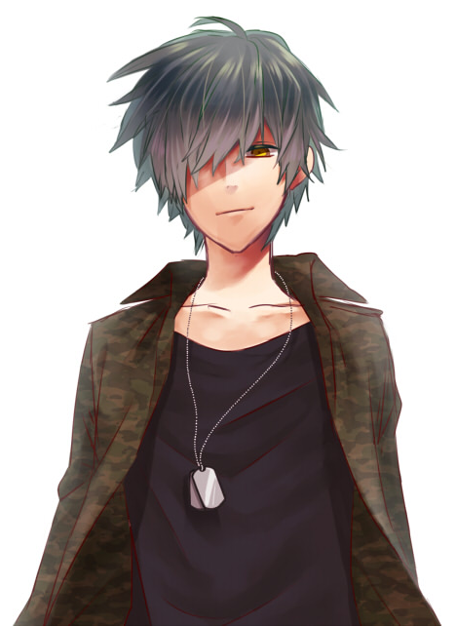
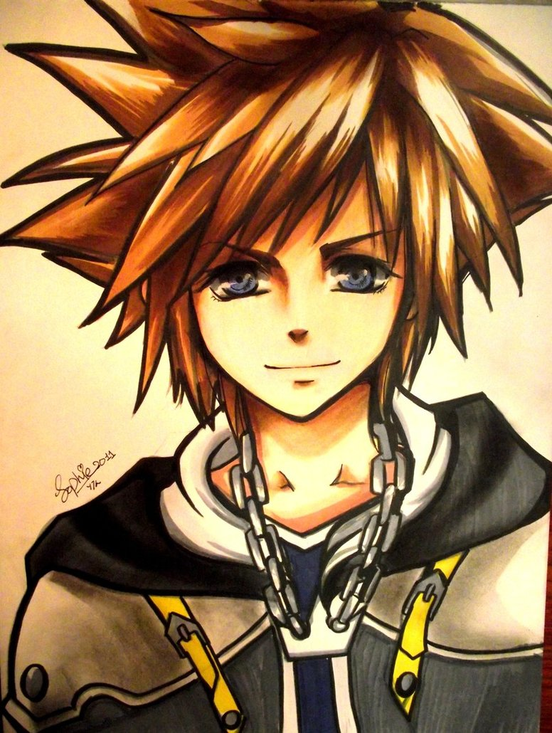

Slide 21
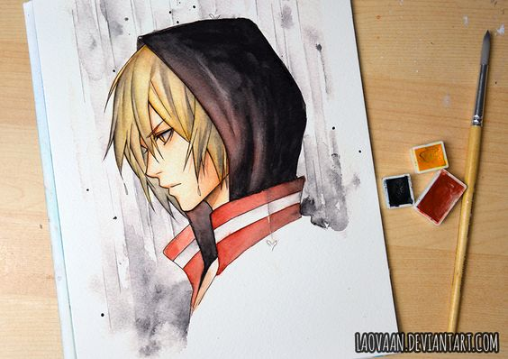
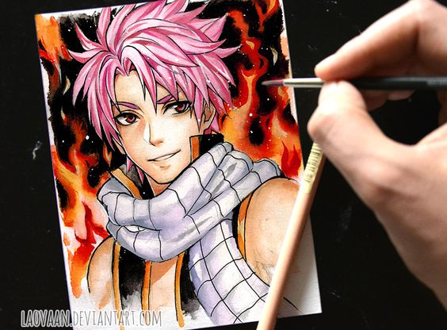

Slide 22
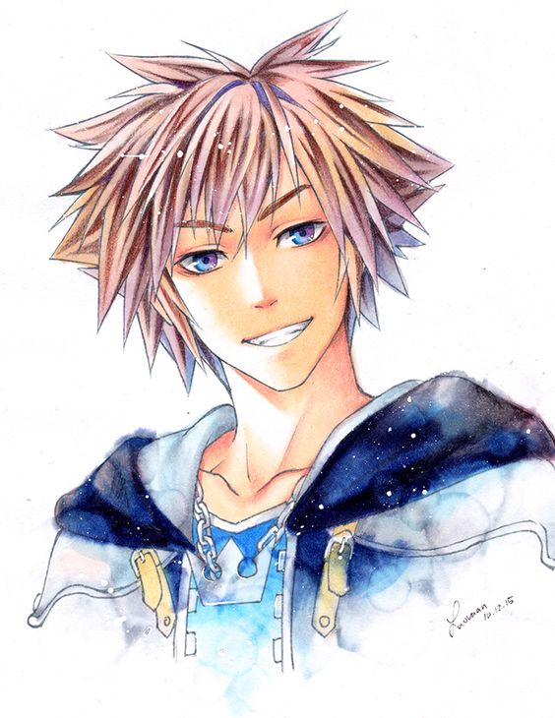
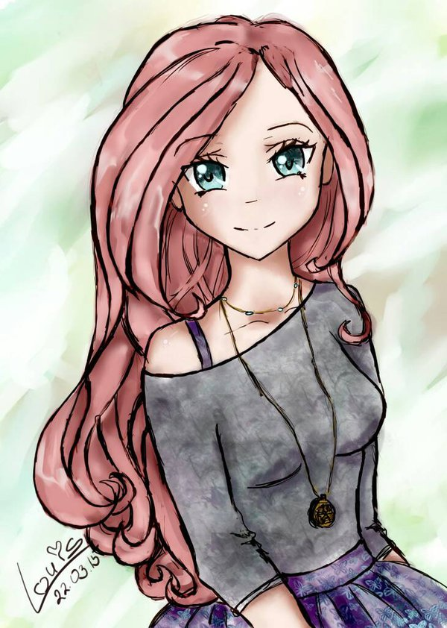

Slide 23
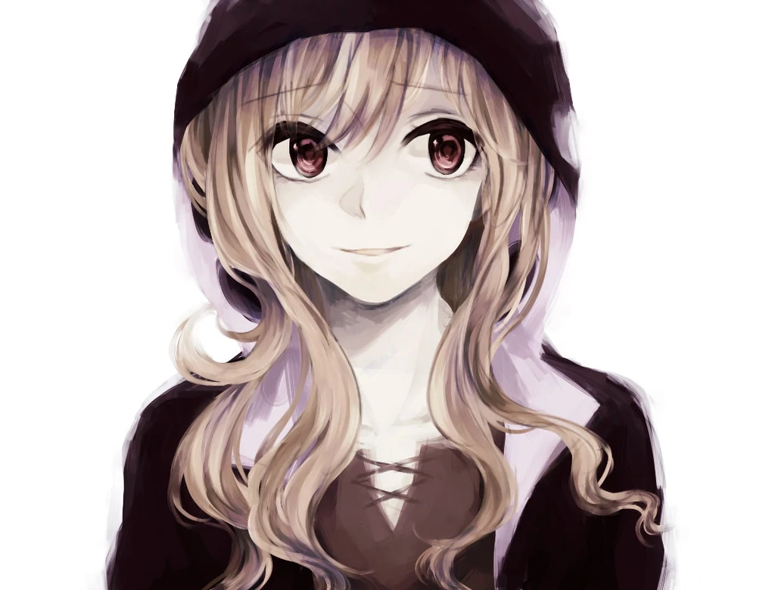

Slide 24
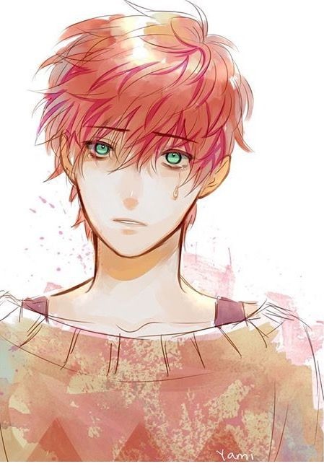

Slide 26
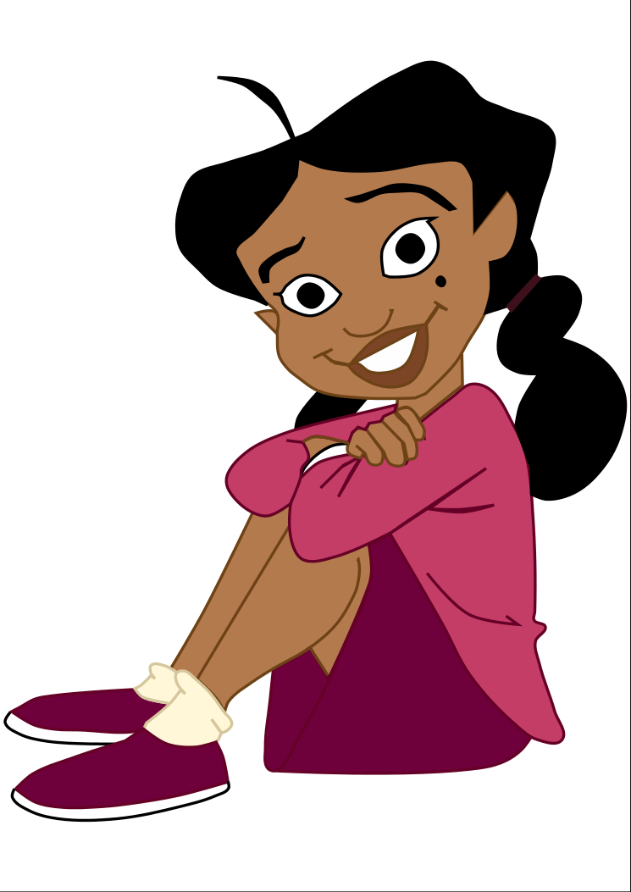

Slide 27
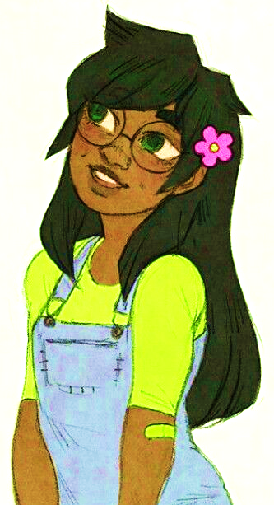
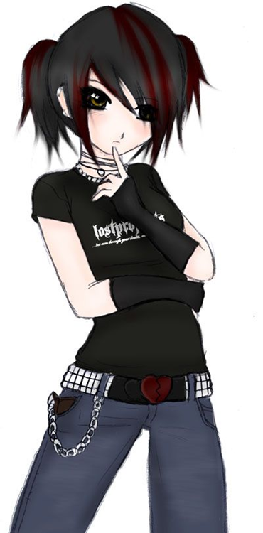

Slide 28
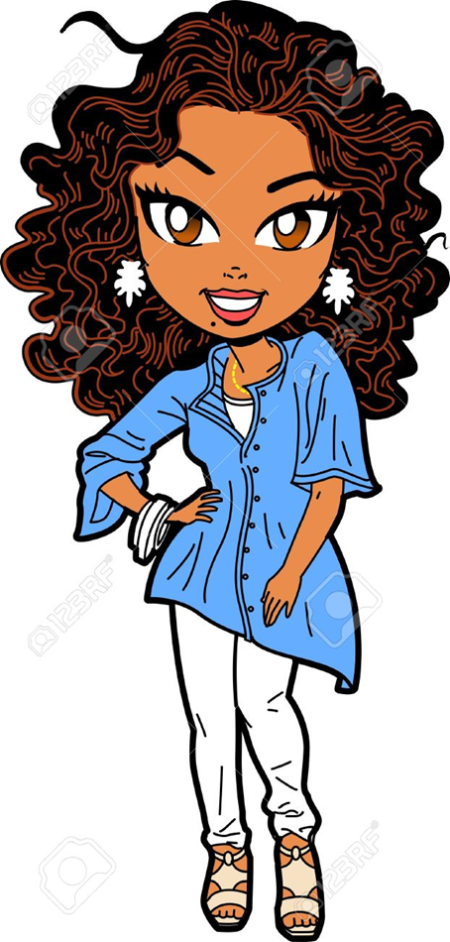

Slide 30
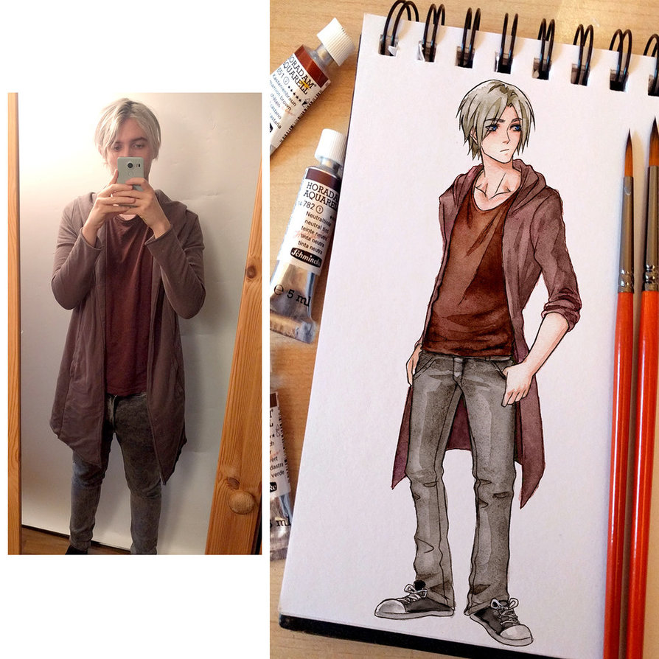

Slide 31
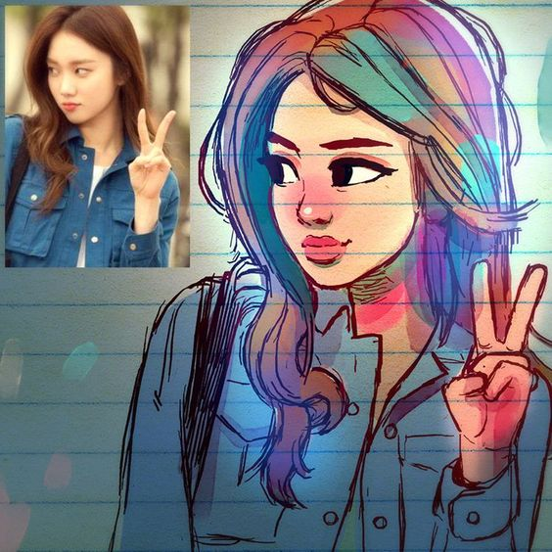
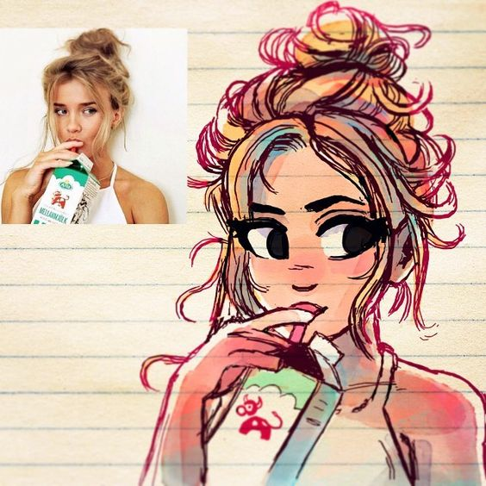
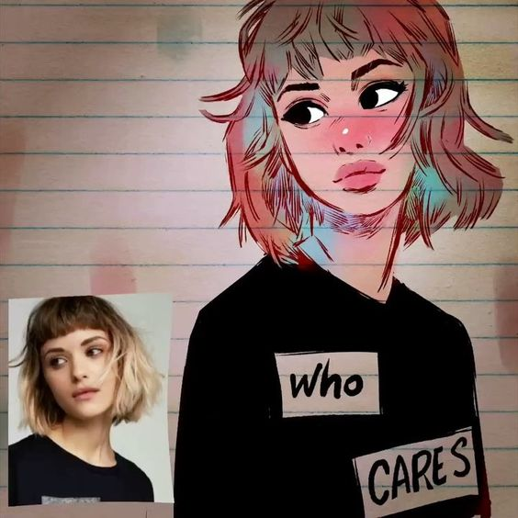
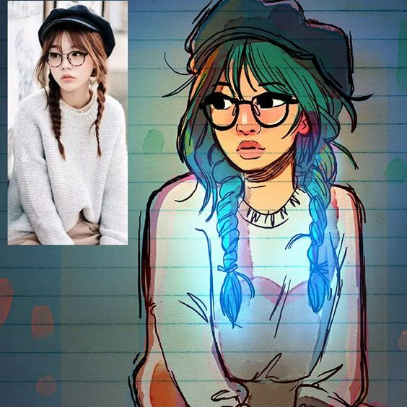

Slide 32
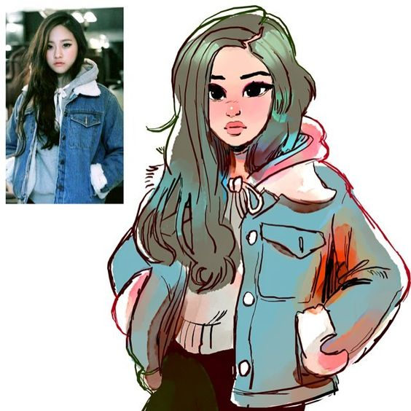

Slide 38
https://faceyourmanga.com/
https://www.youtube.com/watch?v=zCcuAe3q9Fw
https://www.youtube.com/watch?v=b9oP3qWPuiY

